Slide 1


ATLIQ GRAND HOTEL
Hospitality Analysis
-Reshma Selvaraj

Slide 2
ABOUT ATLIQ GRAND’S AND PROBLEM STATEMENT
AtliQ Grands proudly operates a collection of five-star hotels in major Indian cities, including Delhi, Mumbai, Hyderabad, Bangalore, Chennai, and more. Renowned for their luxury and exceptional service, AtliQ Grands has firmly established itself as a key player in India's hotel industry.
AtliQ Grands: Addressing Current Challenges
Industry Position: A well-established player in India's luxury and business hotel sectors.
Challenges: Facing tough competition and declining revenues.
Root Causes: Ineffective decisions and strong competitive pressures.
Strategic Response: Management plans to leverage data and implement smart strategies.
Action Plan: Hiring external data experts to improve decision-making, regain customers, and boost revenue.

Slide 3
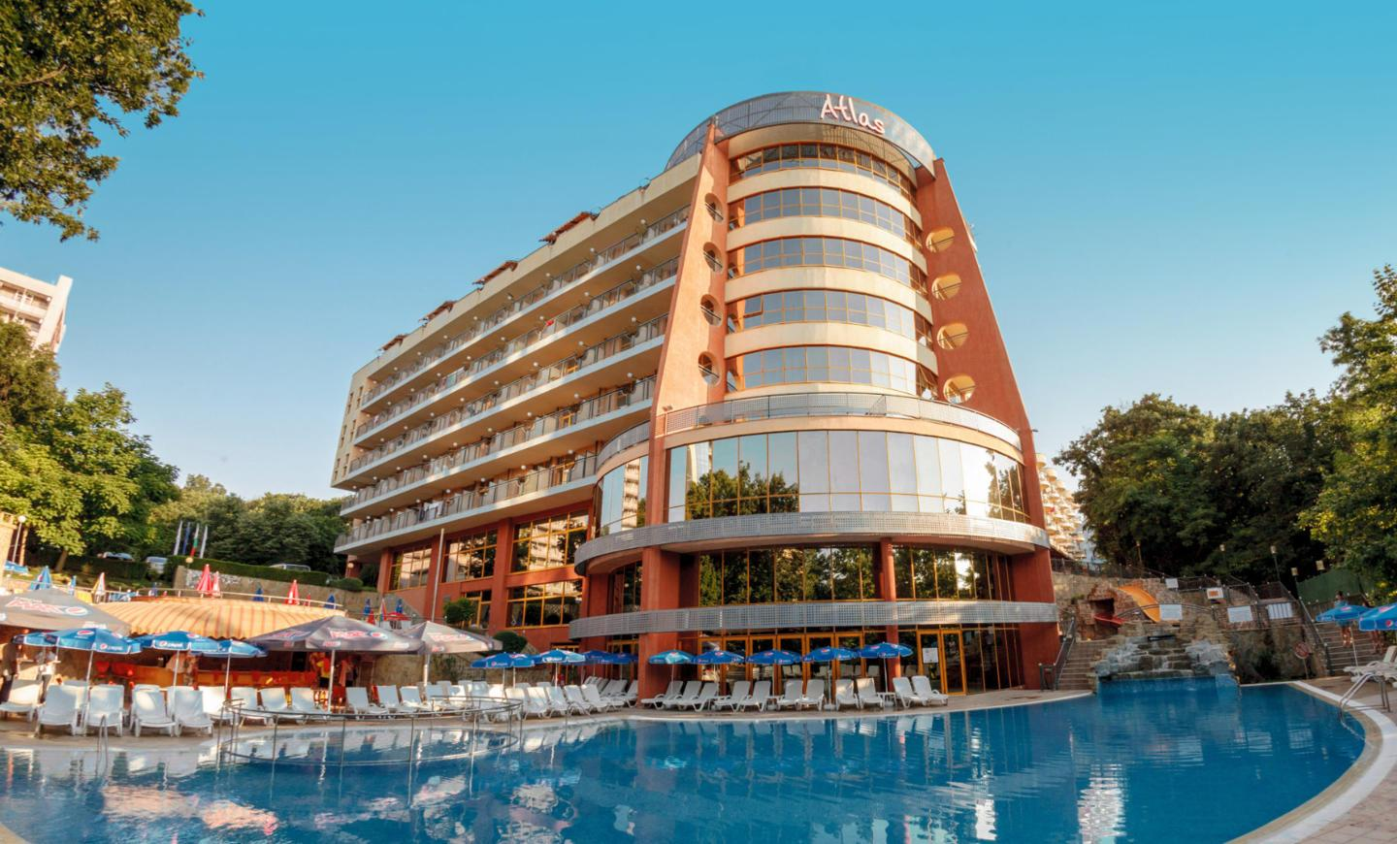
Strategic Goal: Enhancing Market Share and Revenue
Objective: Increase market share and revenue in the luxury and business hotel segment.
Approach: Implement data-driven strategies and leverage business intelligence.
Aim: Outperform competitors and enable more informed management decisions.

Slide 4
ATLIQ GRAND HOTEL CHAIN
Category
Luxury
Business
AtliQ Grands
AtliQ City
Property Name
Property Name
AtliQ Exotica
AtliQ Palace
AtliQ Blu
AtliQ Seasons
AtliQ Bay
Each property 4 room class
Standard
Elite
Premium
Presidential

Slide 5
Key Metrics
ADR (average daily revenue) - average payment for rooms sold in a given time period.
1
DBRN (daily booked room nights) - average numbers of rooms booked per day during a time period.
2
DSRN (daily sellable room nights) - average numbers of rooms available for sale per day during a time period.
3
DURN (daily utilized room nights) - average numbers of rooms successfully used by customers per day during a time period.
4
RevPAR (Revenue Per Available Room) - RevPAR represents the revenue generated per available room, whether or not they are occupied.
5
Realization % - percentage of successfully checked out bookings over all bookings made.
6
Occupancy % - percentage of total successful bookings happened to the total rooms capacity.
7

Slide 6
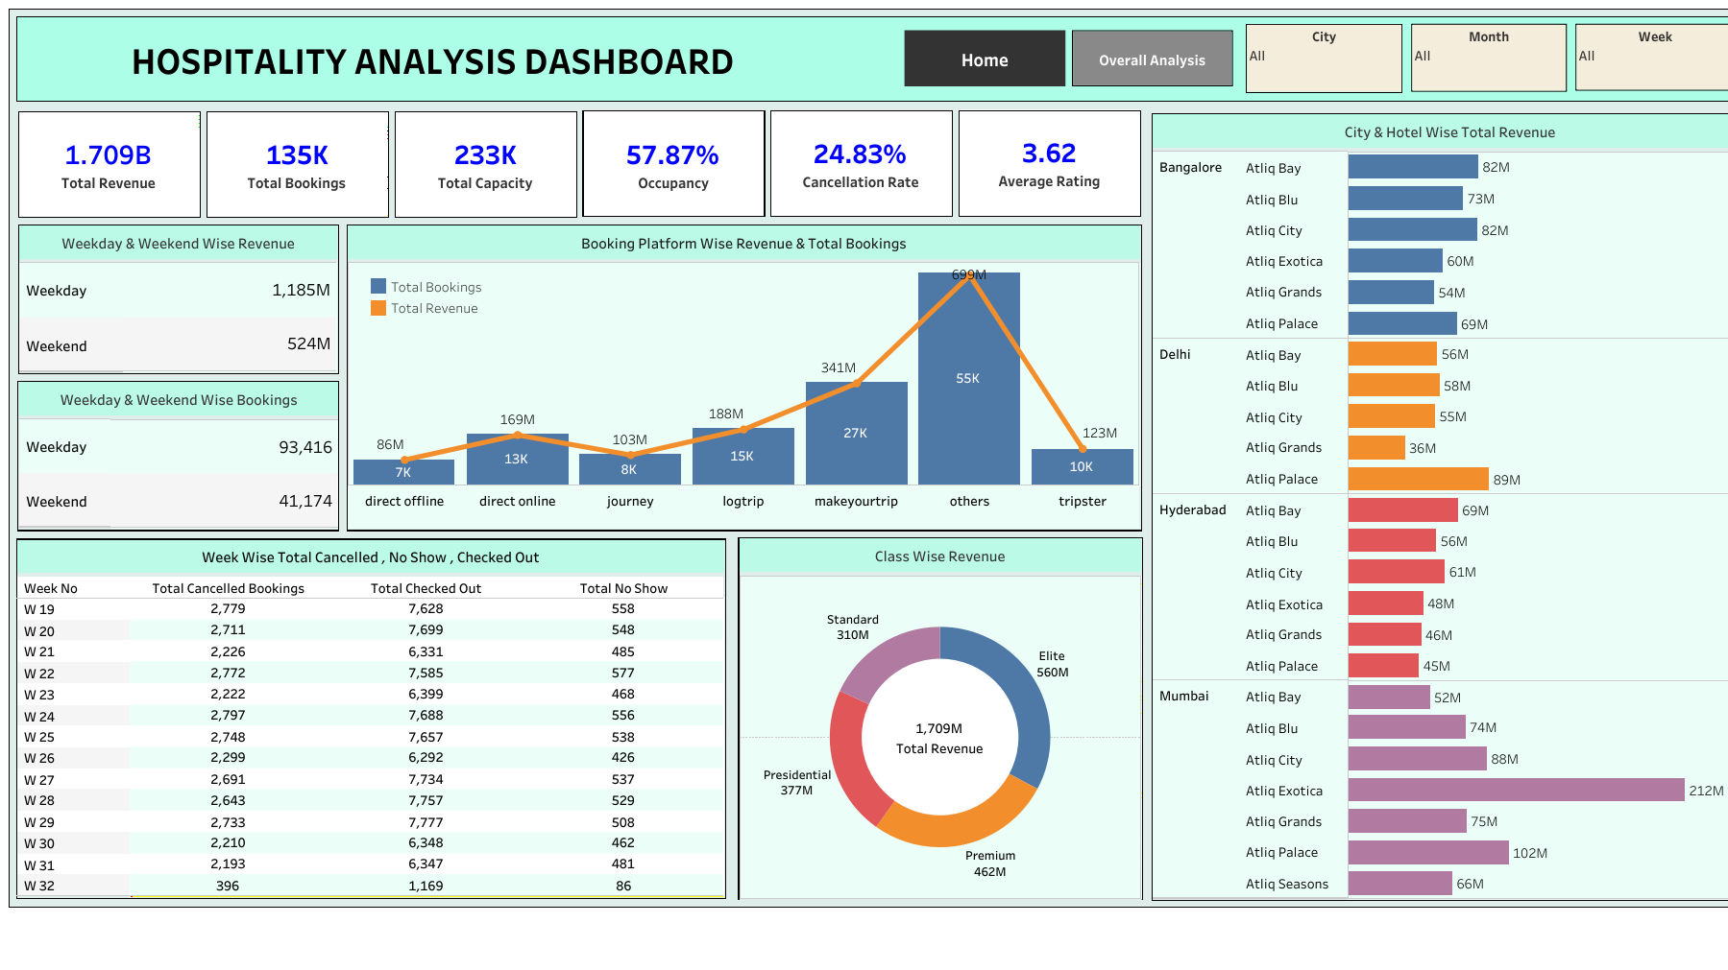
ATLIQ GRANDS – HOSPITALITY ANALYSIS I

Slide 7
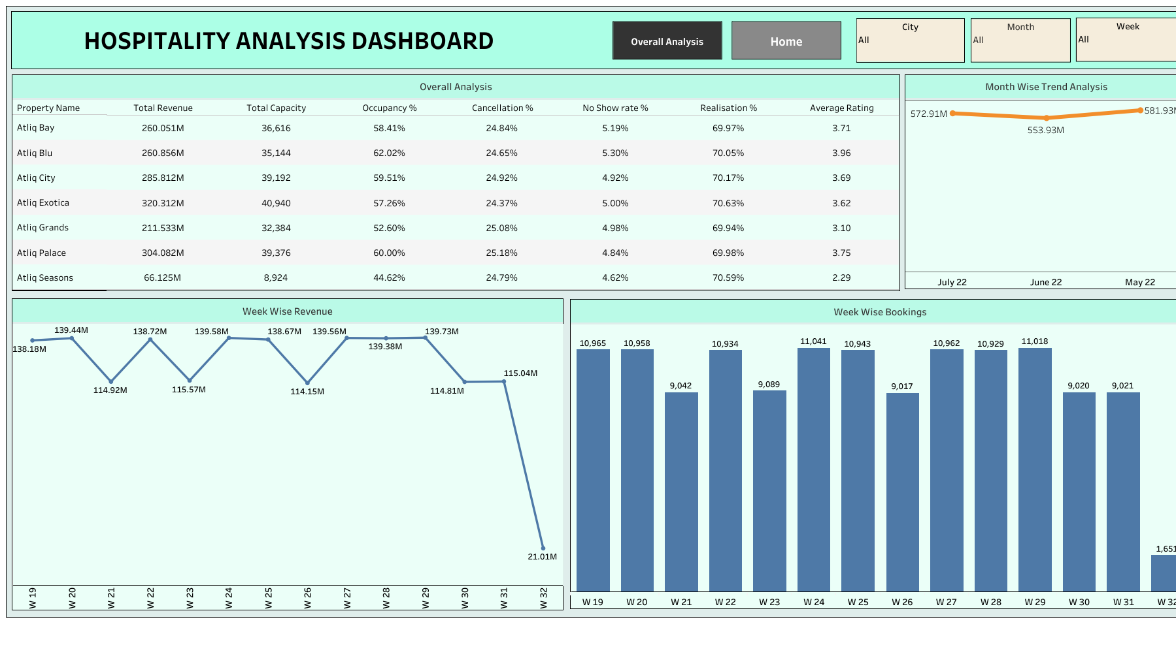
ATLIQ GRANDS – HOSPITALITY ANALYSIS II

Slide 8
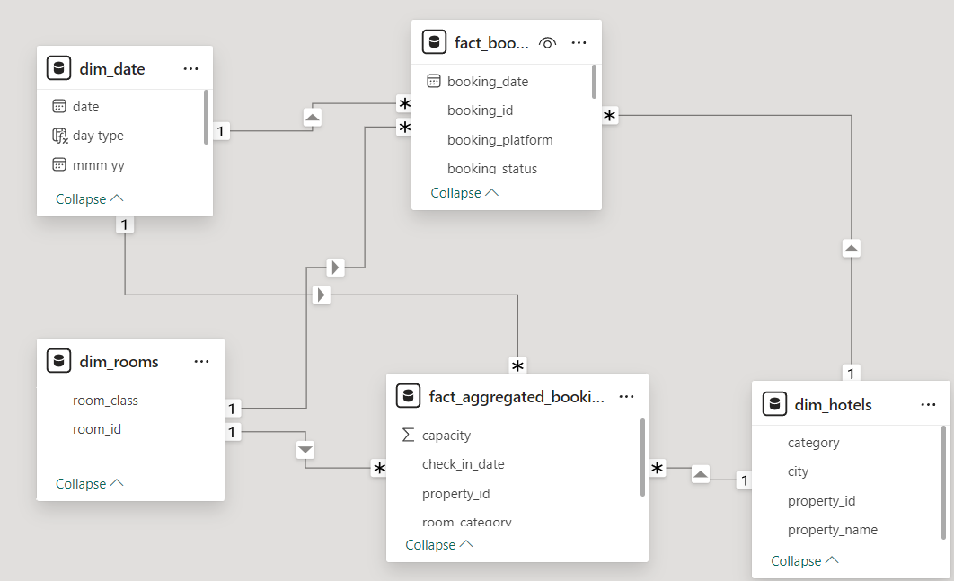
Data Model

Slide 9
Insights -I
Revenue:
Mumbai: Highest revenue at 669M
Delhi: Lowest revenue at 290.92M
Revenue by Category:
Luxury: 61.62% of total revenue (1.69B)
Business: 38.82% of total revenue
Occupancy Rates:
Delhi: Highest at 60.44% despite the lowest DSRN (435)
Bangalore: Lowest at 55.68%
Top Performer:
AtliQ Exotica: Best performer with 316M revenue, 3.62 average rating, 57.20% occupancy, and 24.39% cancellation rate
Weekend Insights:
Weekend (Fri-Sat): 7% higher occupancy compared to weekdays; negligible difference in RevPAR

Slide 10
Insights -II
Monthly Revenue:
May: Highest revenue at 581.93M
Room Class Performance:
Elite Room Class: Highest revenue at 553.74M
Standard Room Class: Lowest revenue at 305.74M
Booking Sources:
Other Sources: Maximum bookings (19K)
Makeyourtrip: Second highest bookings (9K)
Overall Metrics:
Total Revenue: 1.69B
Cancellation: 24.84%
Average Rating: 3.62
RevPAR:
Mumbai: Highest at 8.9K
Hyderabad: Lowest at 5.4K

Slide 11
Recommendations
Improve Customer Ratings:
Focus on enhancing service quality, cleanliness, and food offerings to directly boost bookings and revenue.
Dynamic Pricing Strategy:
Since ADR is consistent on weekdays and weekends, implement dynamic pricing across all properties and platforms to increase revenue.
Address Cancellation Issues:
Makeyourtrip, the second largest booking source (9K bookings), has a high cancellation rate of 25.03%. Address this issue to improve hotel rankings in search results, leading to higher revenue and bookings.
Optimize Room Pricing:
With an overall occupancy rate of 57.79%, dynamically adjust room prices for properties with low occupancy to maximize revenue.

Slide 12
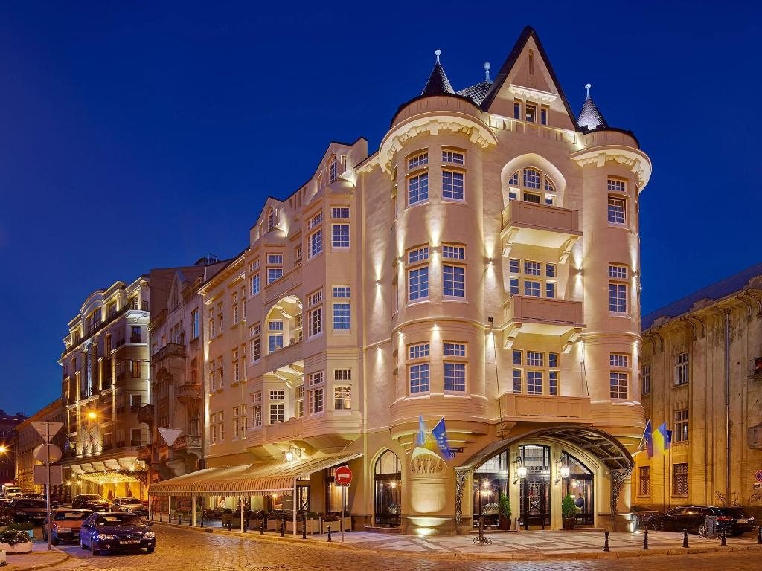
THANK YOU

